Slide 1



Resilience Engineering Framework Integration in Off-Grid Renewable Energy Systems
Faculty of Civil and Industrial Engineering
Department of Mechanical and Aerospace Engineering
Master's Degree in Mechanical Engineering
Academic Year 2023/2024
Candidate:
Pier Luca Anania
1653220
Supervisor:
Andrea Micangeli

Slide 2
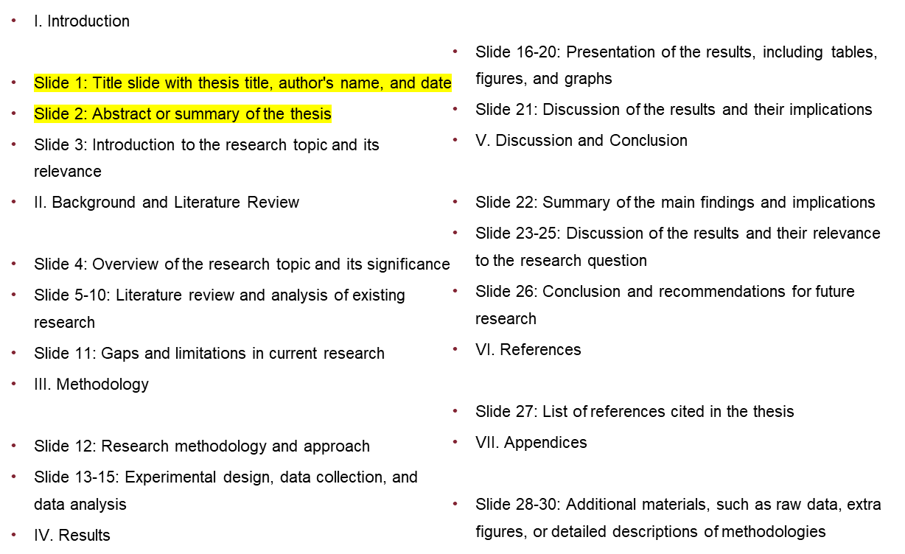
Indice Tesi
Titolo Presentazione
Pagina <number>

Slide 3
Thesis Objective
Objective:
Develop a comprehensive understanding of how resilience engineering concepts can inform and improve anomaly detection strategies in minigrid operations.
Key Focus:
Leverage insights from resilience engineering literature and methodologies to enhance the robustness and adaptability of anomaly detection algorithms.
Analyze an Open-Source dataset on a photovoltaic production plant to identify critical points in the system.
Apply a multidisciplinary and multiobjective approach to structure a resilience engineering framework for a photovoltaic energy production system.
Research Goal:
Inform future strategies for enhancing the reliability and sustainability of decentralized energy
systems by fostering a deeper understanding of the interplay between resilience engineering
and minigrid operations.
Titolo Presentazione
Pagina <number>

Slide 4

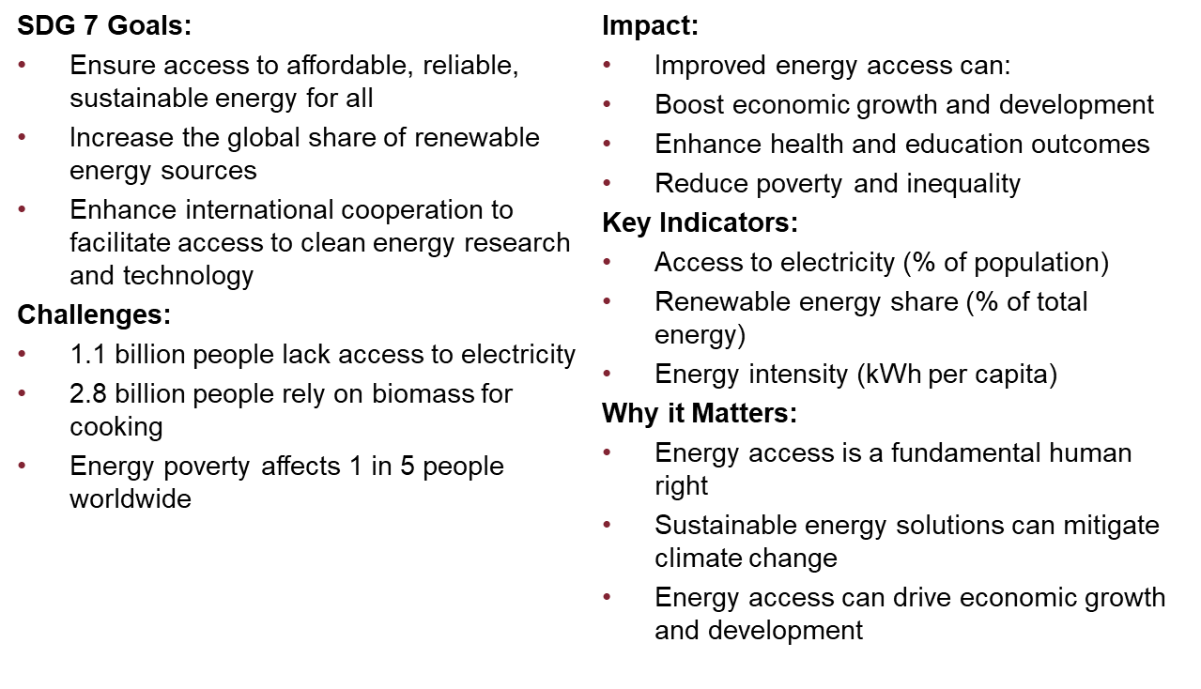
Ensure Access to Affordable, Reliable, Sustainable Energy
Titolo Presentazione
Pagina <number>

Slide 5
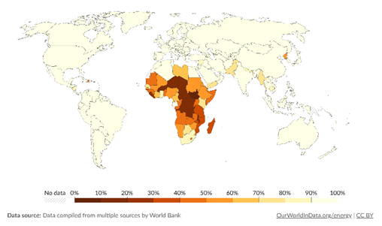
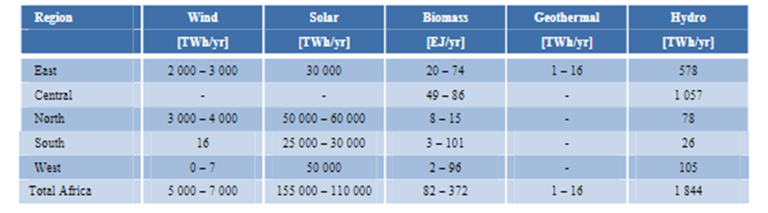
Ensure Access to Affordable, Reliable, Sustainable Energy
Technical potential for renewable energy in Africa by region (IRENA)
Titolo Presentazione
Pagina <number>
Notes:
In questa slide si evidenzia l’Africa come paese con sofferenza di energy access e il potenziale rinnovabile per regione da report Irena

Slide 6
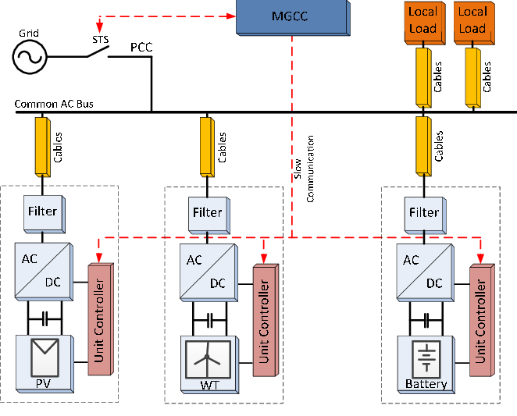
Microgrids: A New Era in Energy Distribution
A microgrid is a local energy system that can operate in isolation from the main grid, providing reliable and efficient energy to a specific area or community.
Key Components:
Generation: Renewable energy sources (solar, wind, hydro) and/or traditional fossil fuels
Storage: Batteries, fuel cells, or other energy storage technologies
Grid Management: Advanced control systems and monitoring software
Load Management: Smart appliances and energy-efficient devices
General Microgrid structure
Titolo Presentazione
Pagina <number>

Slide 7
Microgrids: A New Era in Energy Distribution
Benefits:
Reliability: Improved energy availability and reduced outages
Efficiency: Reduced energy losses and increased efficiency
Sustainability: Increased use of renewable energy sources
Resilience: Enhanced grid stability and reduced vulnerability to natural disasters
Applications:
Remote Communities: Off-grid communities and rural areas
Urban Areas: Neighborhoods and districts with high energy demand
Industrial Sites: Factories, warehouses, and other industrial facilities
Emergency Response: Temporary power solutions for disaster relief and emergency response
Challenges:
Integration: Seamless integration with existing grid infrastructure
Scalability: Balancing energy supply and demand
Cost: High upfront costs and ongoing maintenance
Titolo Presentazione
Pagina <number>

Slide 8
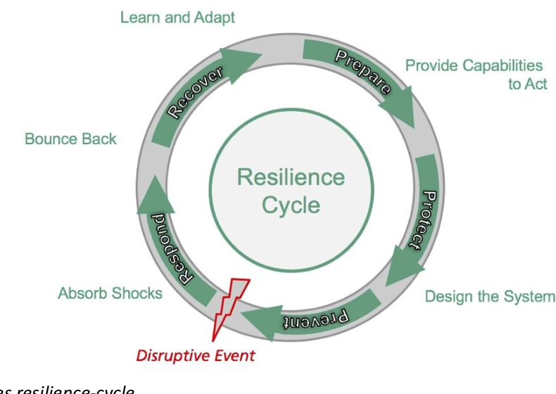

Resilience Engineering: Strategies for System Reliability
Resilience Engineering is a systematic approach to designing and managing complex systems to ensure their ability to withstand and recover from disruptions, while maintaining their functionality and performance.
Key Principles:
Antifragility: Systems that can withstand and learn from shocks and stresses
Adaptability: Systems that can adapt to changing conditions and environments
Redundancy: Systems that have built-in backup and redundancy to ensure continuity
Self-Healing: Systems that can detect and respond to failures and anomalies
Titolo Presentazione
Pagina <number>

Slide 9
Resilience Engineering: Strategies for System Reliability
Benefits:
Improved Reliability: Reduced downtime and increased system availability
Enhanced Performance: Improved system performance and responsiveness
Increased Efficiency: Reduced waste and improved resource allocation
Better Decision-Making: Data-driven decision-making and improved risk management
Applications:
Energy Systems: Grids, power plants, and energy storage systems
Transportation Systems: Airports, seaports, and transportation networks
Cybersecurity: Networks, systems, and data protection
Challenges:
Complexity: Managing complex systems and interdependencies
Uncertainty: Anticipating and preparing for unknown disruptions
Cost: Balancing investment in resilience with other priorities
Titolo Presentazione
Pagina <number>

Slide 10
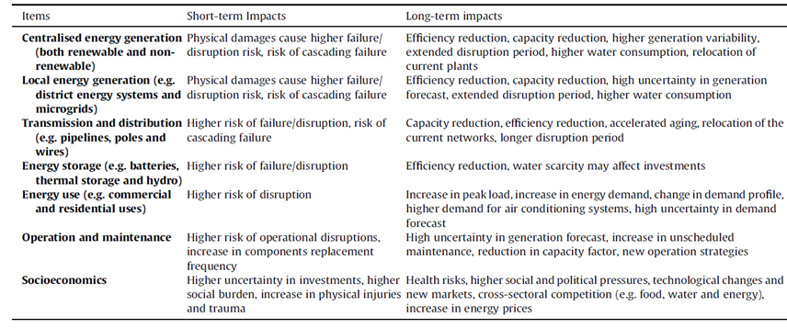
Resilience Engineering: Strategies for System Reliability
Short and long-term impacts of climate-related events on different items of the energy system
Titolo Presentazione
Pagina <number>

Slide 11
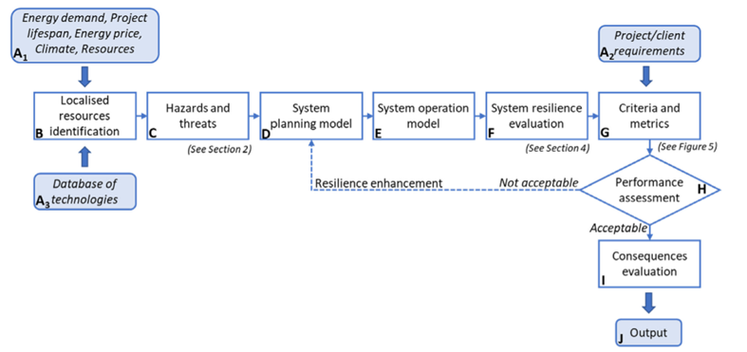
Resilience Engineering: Strategies for System Reliability
Resilience planning process, steps are labelled from A to J
Titolo Presentazione
Pagina <number>

Slide 12
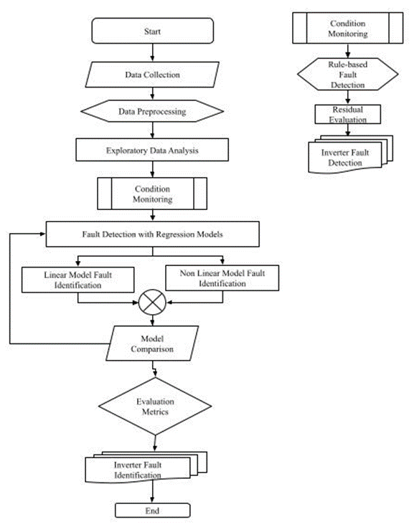
Design of a Hybrid REF – Fault Detection Algorithm
Flowcharts illustrate the operation of an algorithm, providing a clear and intuitive visual representation of the process.
Benefits:
Efficient visualization: Flowcharts help developers understand and analyze the logical flow of instructions
Error reduction: Flowcharts facilitate debugging and reduce errors
Improved efficiency: Flowcharts enable efficient communication and collaboration among team members
Titolo Presentazione
Pagina <number>

Slide 13
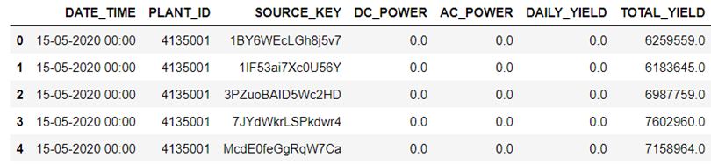
Design of a Hybrid REF – Fault Detection Algorithm
Dataset Overview: Power generation data
DATE_TIME: Date and time for each observation. Observations recorded at 15 minute intervals.
PLANT_ID: this will be common for the entire file
SOURCE_KEY: Source key in this file stands for the inverter id.
DC_POWER: Amount of DC power generated by the inverter (source_key) in this 15 minute interval. [kW]
AC_POWER: Amount of AC power generated by the inverter (source_key) in this 15 minute interval. [kW]
TOTAL_YIELD: This is the total yield for the inverter till that point in time.
Power generation dataset (first 5 rows)
Titolo Presentazione
Pagina <number>

Slide 14
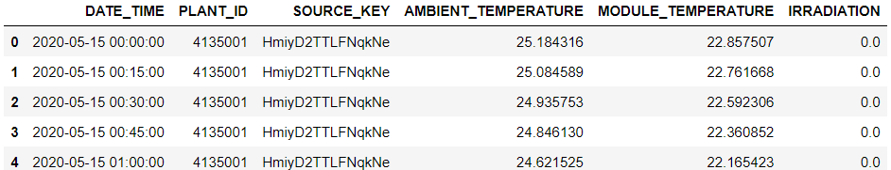
Design of a Hybrid REF – Fault Detection Algorithm
Dataset Overview: Weather Data
DATE_TIME and PLANT_ID already described
SOURCE_KEY: Stands for the sensor panel id. This will be common for the entire file because there's only one sensor panel for the plant.
AMBIENT_TEMPERATURE: This is the ambient temperature at the plant [°C]
MODULE_TEMPERATURE: There's a module (solar panel) attached to the sensor panel. This is the temperature reading for that module. [°C]
IRRADATION: Amount of irradiation for the 15 minute interval. Note: After comparing this data with other publications, I assume the correct unit for this data is [kW/m^2 ]
Weather dataset (first 5 rows)
Titolo Presentazione
Pagina <number>

Slide 15
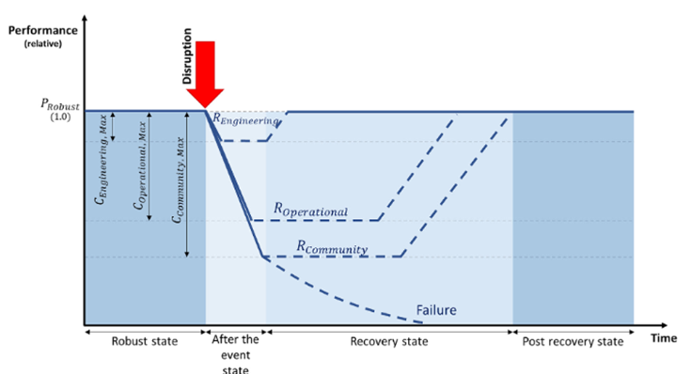
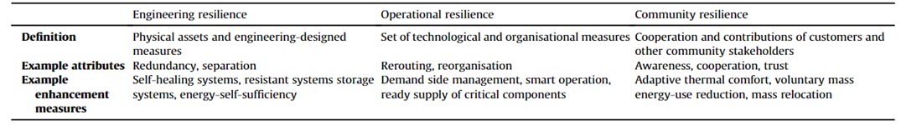
Design of a Hybrid REF – Fault Detection Algorithm
Conceptual multi-phase energy resilience trapezoid
Summary of energy resilience layers for community-level energy master planning
Titolo Presentazione
Pagina <number>

Slide 16
Design of a Hybrid REF – Fault Detection Algorithm
The integration of REF with Fault Detection goes through the control of inverter parameters.
Centralized Power Conversion: Inverters convert DC power to AC power, making them a critical component in microgrid power conversion
High-Risk Component: Inverters are prone to faults due to their complex electronic design and high-power operation
System-Wide Impact: Inverter faults can cause widespread power disruptions and affect the entire microgrid
Why Focus on Inverter Fault Detection?
Early Detection: Identifying inverter faults early can prevent cascading failures and reduce downtime
Improved Reliability: Inverter fault detection enables proactive maintenance and reduces the risk of unexpected failures
Enhanced Grid Stability: Accurate inverter fault detection ensures the microgrid operates within safe and stable operating conditions
Titolo Presentazione
Pagina <number>

Slide 17
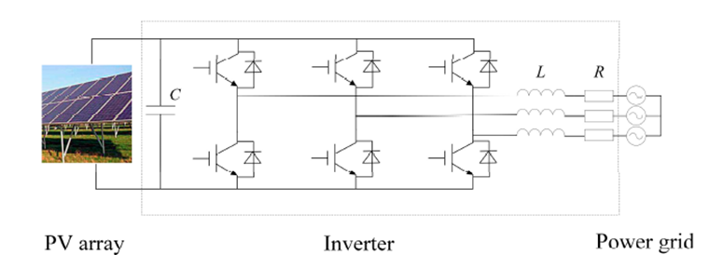
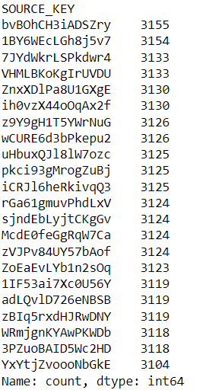
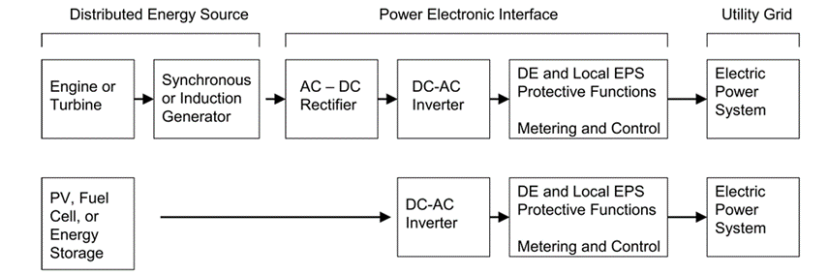
Design of a Hybrid REF – Fault Detection Algorithm
Main circuit of the photovoltaic (PV) power generation system
DER system and PE interface block diagram (Kroposki et al. 2006)
number of acquisitions per inverter (SOURCE_KEY)
Titolo Presentazione
Pagina <number>

Slide 18
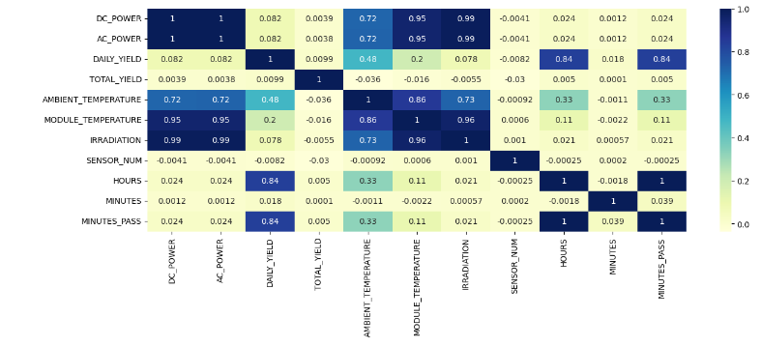
Design of a Hybrid REF – Fault Detection Algorithm
Correlation matrix model applied to power and weather dataset
high correlation between DC Power and AC Power
high correlation between Power and Irradiation
correlation between DC Power, AC Power and Module Temperature and Ambient Temperature
correlation between Daily Yield and Ambient Temperature
Titolo Presentazione
Pagina <number>

Slide 19
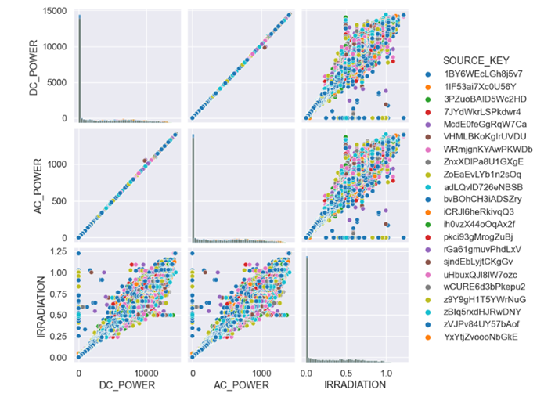
Design of a Hybrid REF – Fault Detection Algorithm
Correlation matrix between AC, DC Power and Irradiation
Titolo Presentazione
Pagina <number>

Slide 20
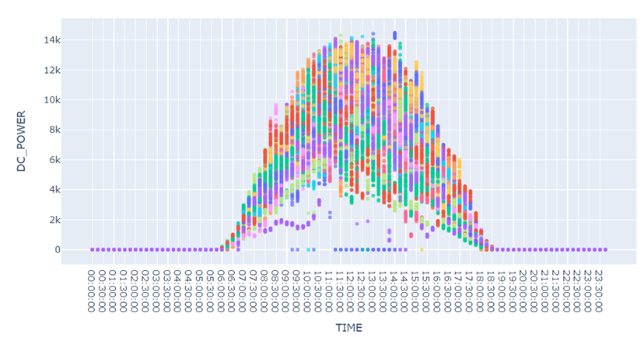
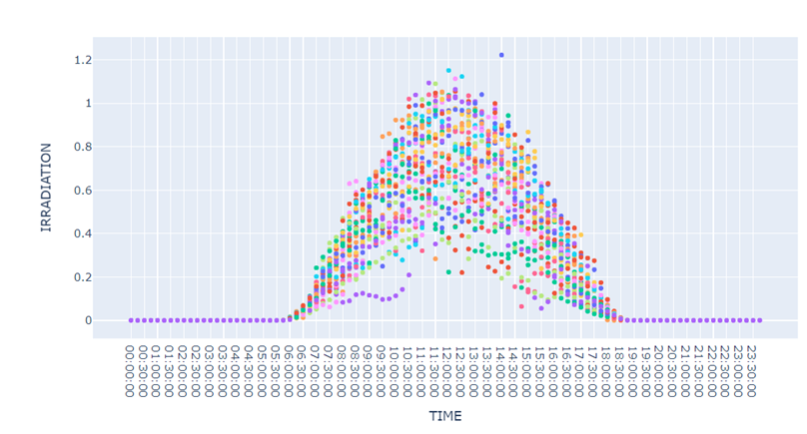
Design of a Hybrid REF – Fault Detection Algorithm
Average DC Power daily distribution
Average Irradiation daily distribution
Titolo Presentazione
Pagina <number>

Slide 21
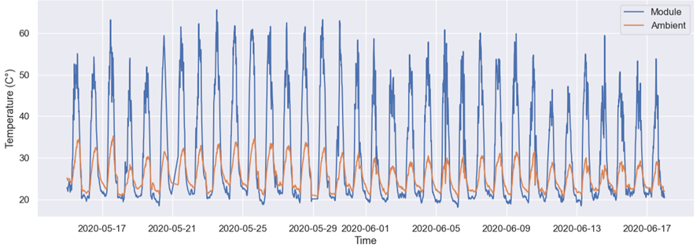
Design of a Hybrid REF – Fault Detection Algorithm
Long-term Module and Ambient Temperature
Titolo Presentazione
Pagina <number>

Slide 22
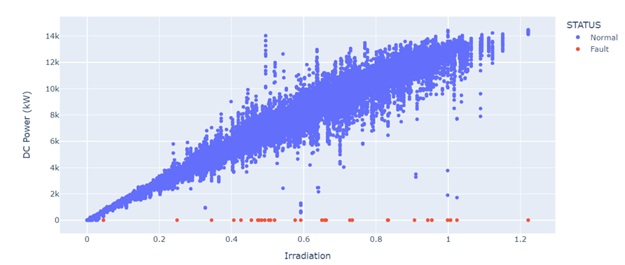
Design of a Hybrid REF – Fault Detection Algorithm
Condition monitoring is a proactive approach to monitoring inverter performance and detecting potential issues before they become major problems.
Predictive Maintenance: Identify and address issues before they cause downtime
Improved Reliability: Reduce the risk of equipment failure and extend inverter lifespan
Increased Efficiency: Optimize inverter performance and reduce energy losses
Fault detection in DC Power – Irradiation correlation
Titolo Presentazione
Pagina <number>

Slide 23
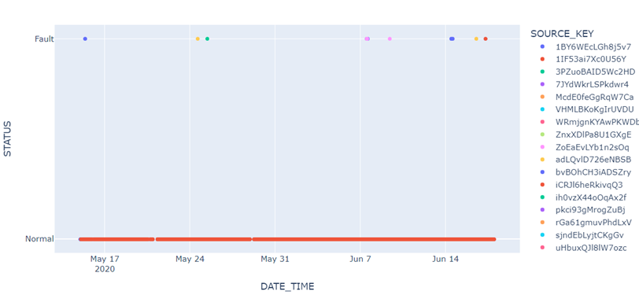
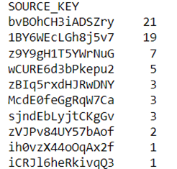
Design of a Hybrid REF – Fault Detection Algorithm
Status of fault related to the inverters along the time
Inverter ID and number of fault events
Titolo Presentazione
Pagina <number>

Slide 24
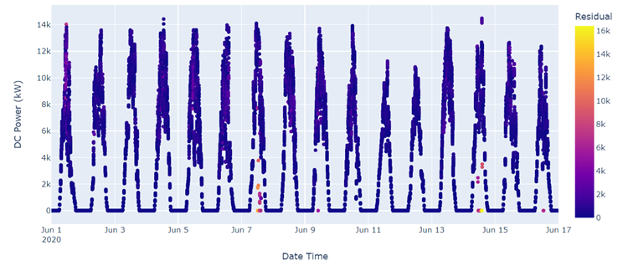
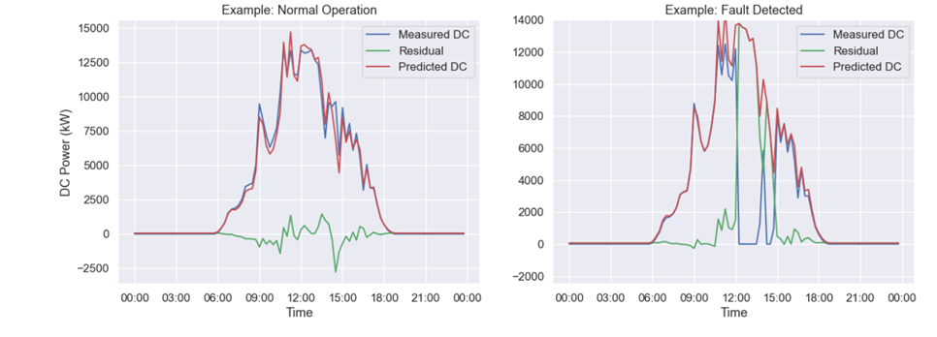
Design of a Hybrid REF – Fault Detection Algorithm
Fault identification result from linear model
DC Power Normal and Fault operations evaluated through the linear model residual computation
Titolo Presentazione
Pagina <number>

Slide 25
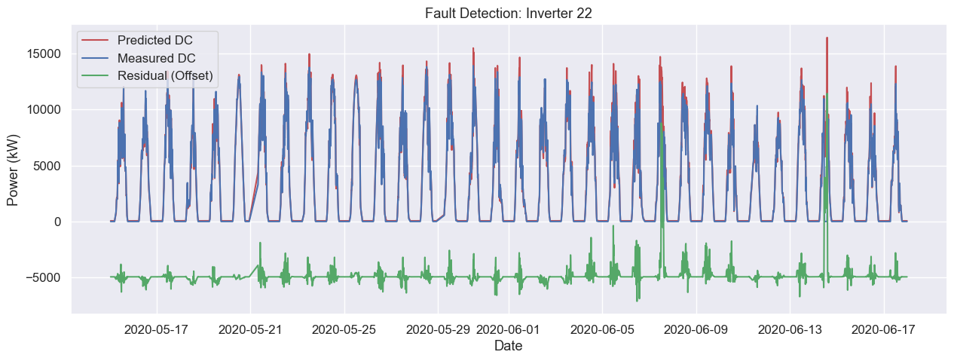
Design of a Hybrid REF – Fault Detection Algorithm
Fault detection evaluation along the entire dataset for the inverter 22
Displayed is the power output (kW) of the Inverter 22 over time, highlighting spikes indicating fault detection instances. These spikes denote moments of detected faults, triggering appropriate responses such as power reduction or shutdown for protection.
Titolo Presentazione
Pagina <number>

Slide 26
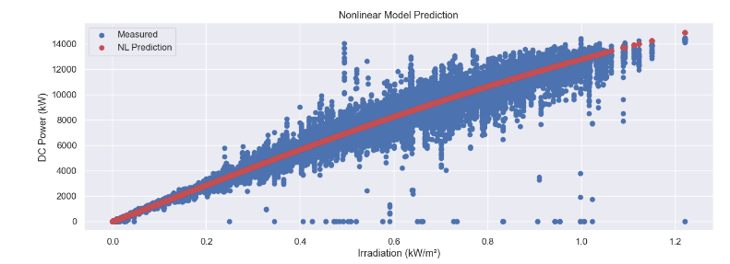
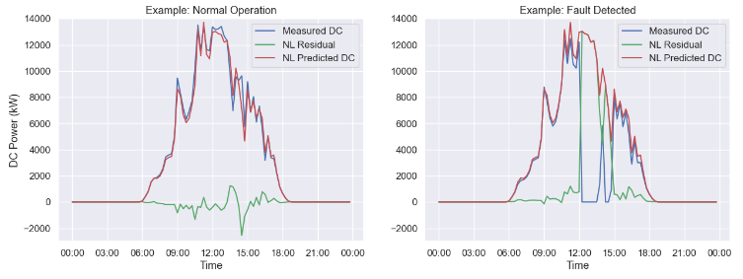
Design of a Hybrid REF – Fault Detection Algorithm
Nonlinear model prediction of DC Power
DC Power Normal and Fault operations evaluated through the nonlinear model residual computation
Titolo Presentazione
Pagina <number>

Slide 27
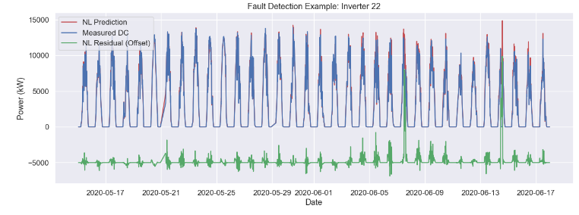
Design of a Hybrid REF – Fault Detection Algorithm
Fault detection evaluation along the entire dataset for the inverter 22 with nonlinear model
This graph presents a comprehensive assessment of fault detection throughout the entirety of the dataset for inverter 22, utilizing a nonlinear model. The plotted data offers insights into the effectiveness of fault detection mechanisms over time, crucial for optimizing performance and ensuring system reliability.
Titolo Presentazione
Pagina <number>

Slide 28
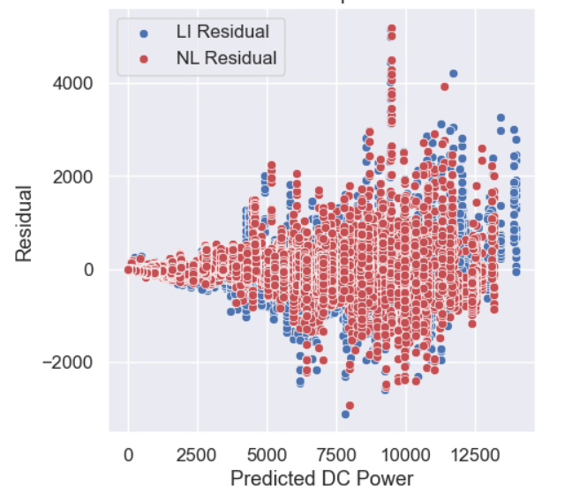
Result and Interpretation
Clustering of residuals around zero indicates accurate predictions by both models.
Sporadic outliers with large residual magnitudes suggest instances where both models deviate significantly from actual values.
Comparison of residual patterns between the linear and nonlinear models can reveal insights into their respective strengths and weaknesses.
Consistent patterns of residuals across predicted DC power levels may indicate systematic biases present in the models.
This analysis aids in assessing the overall predictive performance and identifying areas for model refinement and improvement.
Model comparison between linear and nonlinear model
Titolo Presentazione
Pagina <number>

Slide 29
Limitation and Improvements
Weather’s influence on Microgrid Performance:
External factors like weather conditions can impact fault detection algorithms.
Limited access to comprehensive weather data and advanced forecasting models.
Weather variables affect renewable energy sources and energy demand.
Lack of weather data hampers accurate fault prediction and mitigation.
Mitigation Strategies:
Integration with external weather monitoring systems and forecasting models.
Adaptive strategies based on real-time weather data to enhance microgrid resilience.
Outcome:
Improved fault detection and response capabilities, minimizing disruptions in microgrid operation.
Limitations of Linear Regression in Microgrid Fault Detection:
Assumption of linear relationships may not capture complex dynamics.
Struggles with nonlinear behaviors and abrupt/transient faults.
Dependency on independent input variables and sensitivity to outliers.
Mitigation Strategies:
Consideration of alternative methods like SVMs or ANNs.
Hybrid models combining linear regression with nonlinear techniques.
Integration of real-time data streams for improved responsiveness.
Outcome:
Continuous and efficient energy supply with minimized disruptions.
Titolo Presentazione
Pagina <number>

Slide 30
Conclusions
Conclusion:
Fault detection in microgrids is crucial for reliability and stability.
Linear regression models have limitations in capturing microgrid complexities.
Alternative approaches like advanced machine learning and hybrid models offer more accurate fault detection.
Integration of real-time data enhances responsiveness and effectiveness.
Summary of Main Results:
Literature Review: Synthesized key concepts and frameworks, laying the foundation for understanding resilience in minigrids.
Methodology: Developed and implemented the Resilience Engineering Framework (REF) integrated with anomaly detection algorithms.
Results: The hybrid REF-Anomaly Detection Algorithm effectively identified and interpreted anomalies, enhancing minigrid resilience.
Analysis and Discussion: Evaluated implications and discussed applications and limitations of the integrated approach.
Future Directions:
Further refinement and validation of the integrated framework.
Exploration of additional anomaly detection techniques and resilience indicators.
Application of the framework in real-world minigrid systems to assess its scalability and effectiveness.
.
Titolo Presentazione
Pagina <number>

Slide 31
Grazie per l’attenzione!
Titolo Presentazione
Pagina <number>

